Slide 1

Big data opportunities GE
Big Data opportunities that GE has capitalized on.

Slide 2
GE Aviation's Flight Analytics platform ( implemented in Brazil 2012)
GE Big Data Cuts Airlines’ Carbon Emissions, Operational Costs:
Sporting events 2014 Soccer world cup, Olympic games 2016 have flooded the busy brazilian skies with plane tickets booked in advance. No of passengers have doubled since 2012 and poised to increase at 6% over the next decade maxing out the country's city airports.
Over last 2 years GOL, Brazilian airlines have been working with GE aviation to find a solution. They have started rolling out GE’s Big Data tool - Required Navigation Performance system (RNP) - at 10 key airports in southeast Brazil, including the capital Brasilia. GOL estimates that at the Brasilia airport alone the airline could potentially save 22 miles and 7.5 minutes per landing approach compared to the conventional paths. It could also reduce carbon dioxide emissions by more than 1,620 pounds and bring $24 million in operational savings over five years.

Slide 3
GE Aviation's Flight Analytics platform ( implemented in Brazil 2012)...Contd.
RNP is just one big data tool in GE’s portfolio to improve airline and airport efficiency. Systems developed by Taleris, GE Aviation’s joint venture with Accenture, tap the Industrial Internet and use sophisticated s/w to harvest and analyze gigabytes of data generated by hundreds of sensors working inside airplanes. The tools allow airline like UAE’s Etihad to monitor planes in real time, reduce fuel costs, manage plane maintenance, spot problems before hand.
“Once the RNP paths are deployed, GE Aviation’s Flight Analytics platform will analyze actual flight and operational data to support optimization, validate the cost savings and identify additional areas for improvements,”
“This may include optimizing the paths for additional fuel and track mile savings, vertical profile reduction, capacity gains, runway throughput or environmental improvements.”
-Giovanni Spitale, general manager of GE Aviation’s Flight Efficiency Services.

Slide 4
Megabytes for Megawatts: How GE’s Big Data System Helped Slash Smelter’s Power Bill (implemented in 2012)
Dubai Aluminium (DUBAL) runs one of the largest aluminum plants in the world consuming 90 % of the power produced by its private power plant. Its seawater desalination plant processes 30 million gallons per day. DUBAL’s electricity bill adds up to a third of its production costs. This is expensive. Six years ago, with Chinese competition growing, Dubai Aluminium (DUBAL) asked GE to cut the plant’s power appetite.
GE built DUBAL an “intelligent” big data system that monitors and gathers information from thousands of locations around the plant’s power grid, and feeds it to a cluster of computer servers. They crunch the data, and optimize electricity flows and power generation. The system monitors grid capacity and sends power around busy points through open cables.

Slide 5
Megabytes for Megawatts: How GE’s Big Data System Helped Slash Smelter’s Power Bill (implemented in 2012)...Contd.
If the electrical resistance data is incorrect, the power could go the wrong way. The more data one has, the better power management job can be done. The system collects megabytes of real-time information like substation voltage and transformer data every few seconds from more than 10,000 points on the grid. All this information flows to a control room, where another software application builds a snapshot of the grid and displays it on a single computer screen.
New System was developed by GE workers in Florida and customized by a team of engineers in Hyderabad, India, makes the DUBAL smelter 22 percent more efficient, cuts nitrogen oxide by nearly a third, and saves the company $4 million in annual fuel costs. In fact, DUBAL saves so much in electricity expenses that the upgrade will pay for itself in just three years.

Slide 6
GE big data to power machine services business
"The airline industry spends $200bn on fuel per year so a 2% saving is $2bn. GE provides software that enables airline pilots to manage fuel efficiency." -Bill Ruh vice-president, GE Research software.
GE manufactures jet engines, turbines and medical scanners. It uses operational data from sensors on its machinery and engines for pattern analysis. One third of GE's business is about servicing equipment. Zero downtime can make considerable savings and this has become the main focus of GE
Another product, Movement Planner, is a cruise control system for train drivers. The technology assesses the terrain and the location of the train to calculate the optimal speed to run the locomotive for fuel economy.
GE uses NoSQL and Hadoop and developed own database for time series analysis. GE is also working with Microsoft Azure and Amazon Web Services to investigate how to offload processing to the cloud.

Slide 7
GE Proficy – GE Ecomagination product
GE’s Proficy® Software platform is used worldwide for industrial applications to provide insight into process and asset performance and identify ways to reduce costs and take corrective actions. This enables companies to increase productivity and efficiency, and decrease energy consumption and associated CO2 emissions.

Slide 8
BigData ETL tools - Syncsort
Syncsort Hadoop Solutions
helps overcome the challenges of collecting, processing and integrating data in Hadoop. For wider Hadoop adoption: connect, develop, deploy, re-use, and accelerate. No programming or tuning required.
Syncsort Incorporated headquartered at Woodcliff Lake, New Jersey, United States is a software company specializing in high speed sorting products, Data Integration, backup software and services, for Microsoft Windows, UNIX, LINUX and mainframe systems. Syncsort products are used by over 90 of the Fortune 100 companies and can be found in over 12,000 customer sites. In 2010, Syncsort delivered a data protection product for NetApp storage. It has offices in France, Germany, and the United Kingdom, with an international support center in The Netherlands. Syncsort customers operate in a range of industries, including manufacturing, consumer goods, transportation, local and federal governments, and health care.

Slide 9
Big Data ETL tools - Pentaho
Pentaho Data Integration:
Pentaho data integration prepares and blends data to create a complete picture of your business that drives actionable insights. The complete data integration platform delivers accurate, “analytics ready” data to end users from any source. With visual tools to eliminate coding and complexity, Pentaho puts Big Data and all data sources at the fingertips of business and IT users alike.
Graphical ETL tool to load and process big data sources in familiar ways.
Rich library of pre-built components to access, transform data from various sources.
Visual interface to call custom code, analyze images and video files to create meaningful metadata.
Dynamic transformations, using variables to determine field mappings, validation and enrichment rules. Integrated debugger for testing and tuning job execution.

Slide 10
Big Data ETL tools - Talend
What it Does: Integration at Cluster Scale
Talend’s big data product combines big data components for MapReduce, Hadoop, HBase, Hive, HCatalog, Oozie, Sqoop and Pig into a unified open source environment so you can quickly load, extract, transform and process large and diverse data sets from disparate systems.
How it Works: Big Data Without The Need To Write / Maintain Code
Talend provides an easy-to-use graphical environment that allows developers to visually map big data sources and targets without the need to learn and write complicated code. Running 100% natively on Hadoop, Talend Big Data provides massive scalability. Once a big data connection is configured the underlying code is automatically generated and can be deployed remotely as a job that runs natively on your big data cluster - HDFS, Pig, HCatalog, HBase, Sqoop or Hive.

Slide 11
ETL tools – Talend Contd.
Big Data Distribution and Big Data Appliance Support
Talend's big data components have been tested and certified to work with leading big data Hadoop distributions, including Amazon EMR, Cloudera, Greenplum/Pivotal, Hortonworks and MapR. Talend provides out-of-the-box support for big data platforms from the leading appliance vendors including Greenplum/Pivotal, Netezza, Teradata, and Vertica.
Open Source
Using the Apache software license means developers can use the Studio without restrictions. As Talend’s big data products rely on standard Hadoop APIs, users can easily migrate their data integration jobs between different Hadoop distributions without any concerns about underlying platform dependencies. Support for Apache Oozie is provided out-of-the-box, allowing operators to schedule their data jobs through open source software.

Slide 12
ETL tools – Talend Contd.
Pull Source Data from Anywhere Including NoSQL
With 450+ connectors, Talend integrates almost any data source so you can transform and integrate data in real-time or batch. Pre-built connectors for HBase, MongoDB,Cassandra, CouchDB, Couchbase and Neo4J speed development without requiring specific NoSQL knowledge. Talend big data components can be configured to bulk upload data to Hadoop Hadoop or other big data appliance, either as a manual process, or an automatic schedule for incremental data updates.

Slide 13
Developments
Pivotal is the recent high-profile spin-off of EMC and VMWare that got $105 million funding from GE in late April 2013. Pivotal will use its Cloud Foundry platform and Hadoop-based tech to support GE. Amazon will be the first cloud provider on which GE will deploy its industrial Internet platform. Accenture and GE will jointly develop new tech and analytics apps that leverage big data.
GE's Fuel and Carbon Solution (F&CS) use onboard computers, sophisticated software and proprietary analytics to optimize jet fuel use, reduce operating costs, and cut carbon dioxide emissions. If an average-sized airline used F&CS to achieve a 2% improvement in fuel consumption, it would be equivalent to removing more than 10,000 cars from our roads.

Slide 14
GE Big Data Benefits/Estimations
150 Billion dollars in waste across major industries that the Industrial Internet can eliminate.
22 Billion dollars is wasted annually by commercial airlines due to flight delays and unexpected fuel consumption.
46% Percent of the global economy that can benefit from the Industrial Internet.
Efficiency gains as small as 1% could have sizable benefits over 15 years
  Oil and Gas $90bn
  Power $66bn
  Health Care $63bn
  Aviation $30bn
  Rail $27bn

Slide 15
SPOCs GE and TCS CoE
Tcs is carrying out two Big data Hadoop projects for GE
1- GE Software COE - Pivotal HD - team of 4 Associates involved in administration, documentation and security implementation.
2- GE Capital - Hadoop - team of 1 associate -involved in RTS Support - Job monitoring and enhancement
3- Projects on Structured big data sing analytical datanase vectorwise at GE P&W
SPOCs
GE Software CoE Big Data- Beena A
GE capital Big Data- Tarun M
TCS – Pratheesh, Anila V, Asif k, Anoop KumarKm

Slide 16
New Probable markets
Defence sector untapped market: Big Data analysis of asset movement data.
Satellites can continuously transmit large amounts of spatial data that can be captured. This data can be extracted, stored and analysed to form a meaningful pattern. This can be utilized for strategic planning and risk mitigation saving huge efforts and costs.

Slide 17
New Probable markets
Defence sector untapped market: Big Data analysis of asset movement data.
Satellites can continuously transmit large amounts of spatial data that can be captured. This data can be extracted, stored and analysed to form a meaningful pattern. This can be utilized for strategic planning and risk mitigation saving huge efforts and costs.

Slide 18
Pivotal HD
Pivotal HD is an Apache Hadoop distribution that natively integrates the industry- leading EMC Greenplum massively parallel processing (MPP) database technology with the Apache Hadoop framework.
EMC's new Pivotal HD ™ is an Apache Hadoop distribution that natively integrates the industry-leading EMC Greenplum massively parallel processing (MPP) database technology with the Apache Hadoop framework.
The engineering innovation and technology called HAWQ™, brings Greenplum's decade of research and development on the industry's best MPP analytical database platform to Apache Hadoop, the open-source Big Data platform.
New HAWQ technology brings more than 100X performance improvement (in some cases up to 600X) to a wide range of query types and workloads, making Pivotal HD the single most powerful Hadoop distribution in the industry.
Pivotal HD with HAWQ represents the world's first true SQL processing for Hadoop, expanding the platform's reach to SQL programmers

Slide 19
Why Pivotal HD?
The move addresses a common concern among Big Data practitioners. While Hadoop has proven itself a scalable, cost effective Big Data storage and processing platform, analyzing data in Hadoop is a complex affair. It requires analysts skilled in writing MapReduce jobs in Java and who have a thorough understanding of distributed computing.
This limitation means Hadoop is not accessible to most business analysts and other skilled data professionals who are instead versed in SQL to access and analyze data stored in relational databases. To overcome this limitation, most Hadoop early adopters wishing to provide business analysts access to data in Hadoop rely on connectors to move data between Hadoop and existing relational database systems.
This approach has numerous drawbacks, including adding yet more complexity to already stressed data infrastructures and increased total time to insight.

Slide 20
Why Pivotal HD?
By integrating the Greenplum database inside Hadoop, Pivotal HD reduces this need to move data between systems for analysis. Rather, analysts may perform queries using standard ANSI SQL on data stored in HDFS and expect near-real-time query results. Inclusion of the Greenplum database inside Hadoop also removes the delays associated with moving data between systems.
The key technological developments behind Pivotal HD, which allow for high-speed data loading and high-performance SQL queries against data stored in HDFS, are what Greenplum calls data pipelining and HAWQ.
Wikibon believes that for Big Data to live up to its promise, practitioners and vendors must move towards the development of a comprehensive Big Data platform/framework that:
■ Facilitates all manner of workloads - analytic and transactional, batch and real-time;
■ Stores and processes all data - structured, unstructured and everything in between;
■ And is useful to seasoned Data Scientists and regular business users alike.

Slide 21
Why Pivotal HD?
Pivotal HD is a positive step in this direction and Greenplum should be applauded for putting forth a vision for the future of Big Data. With Pivotal HD, Greenplum is attempting to provide the leadership customers are craving to help them successfully navigate the transition to the Big Data Era.
Pivotal HD contains the usual suspects of a standard Hadoop distribution – HDFS, Pig, Hive, Mahout, Map-Reduce, etc. – but adds a number of other components shown in the architectural snapshot below:

Slide 22
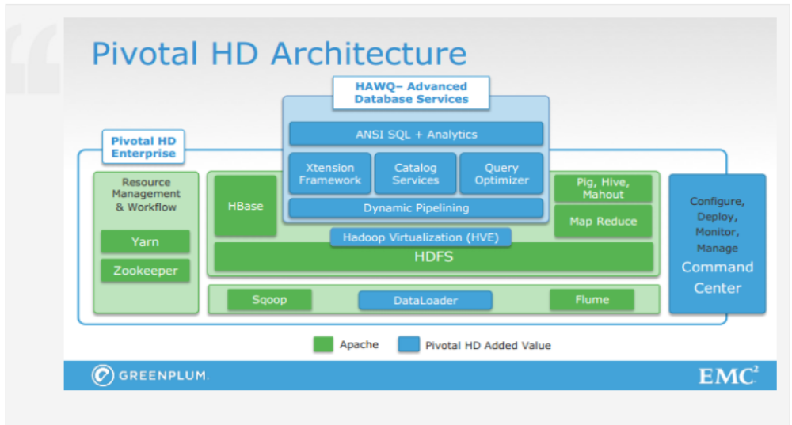
Why Pivotal HD?
.

Slide 23
Why Pivotal HD?
The main component of Pivotal is HAWQ, a MPP (Massively Parallel Processing) relational database running directly on HDFS in Hadoop through a dynamic pipelining mechanism and featuring:
SQL Compliant – supporting all versions of SQL: ‘92, ‘99, 2003 OLAP, etc. 100% compatible with PostgreSQL 8.2.
Row or column-oriented data storage
Query Optimizer – queries can be run on hundreds of thousands of nodes
Fully ODBC/JDBC compliant
ŸInteractive Query – complex queries on large data sets solved in seconds /sub-seconds
Data management – provides table statistics, table security
Supports data stored in HDFS, Hive, HBase, Avro, ProtoBuf, Delimited Text and Sequence Files
Deep analytics – including data mining or machine learning algorithms

Slide 24
Pivotal HD - Maximize Business Value From all Your Data
– Deliver Hadoop with Enterprise Capabilities and Flexibility
Open-source Hadoop frameworks have rapidly emerged as preferred technology to grapple with the explosion of structured and unstructured big data. You can accelerate your Hadoop investment with an enterprise-ready, fully supported Hadoop distribution that ensures you can harness—and quickly gain insight from—the massive data being driven by new apps, systems, machines, and the torrent of customer sources.

Slide 25
Pivotal HD - Maximize Business Value From all Your Data
– Accelerate Hadoop with Existing SQL Skillsets
HAWQ adds SQL’s expressive power to Hadoop to accelerate data analytics projects, simplify development while increasing productivity, expand Hadoop’s capabilities and cut costs. HAWQ can help your organization render Hadoop queries faster than any Hadoop-based query interface on the market by adding rich, proven, parallel SQL processing facilities. research and development to the Apache Hadoop framework, HAWQ leverages your existing business intelligence and analytics products and your workforce’s SQL skills to bring more than 100X performance improvement (in some cases up to 600X) to a wide range of query types and workloads. The world’s fastest SQL query engine on Hadoop, HAWQ is 100 percent SQL compliant. The first true SQL processing for enterprise-ready Hadoop, Pivotal HD with HAWQ is available as software only or as an appliance-based solution.

Slide 26
Pivotal HD - Maximize Business Value From all Your Data
– The Industry’s First Platform for Closed Loop Analytics
GemFire XD, built on over a decade of innovation in real-time distributed systems, integrates with Pivotal HD and HAWQ to provide the industry’s first platform for creating closed loop analytics solutions. By combining OLTP and OLAP using Hadoop as the common storage layer, GemFire XD can allow your business to make prescriptive decisions in real time.
By combining the real day-to-day events of your business with your analytics systems, which knows how your business behaves, you can act prescriptively to events while they are happening.

Slide 27
GemFire XD
GemFire XD provides:
•Ever growing data sets with linear scalability and continuous uptime with the scale of big data
•Direct write to a big data store (HDFS) allowing for back-end analyticsv
•SQL without the penalties of relational databases
•All of the benefits of over a decade of innovation with GemFire

Slide 28
Links
links:
http://wikibon.org/wiki/v/EMC_Integrates_Greenplum_DB_and_Hadoop_with_Pivotal_HD
http://www.infoq.com/news/2013/02/Pivotal-HD-SQL-Hadoop
http://www.gopivotal.com/products/pivotal-hd
http://india.emc.com/about/news/press/2013/20130225-04.htm

Slide 29
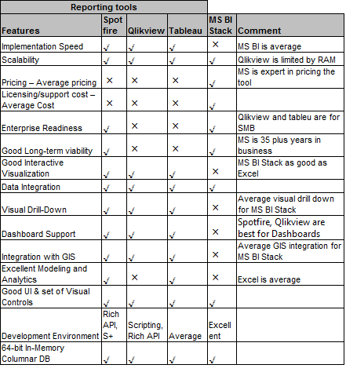
Reporting tools comparison
.

Slide 30
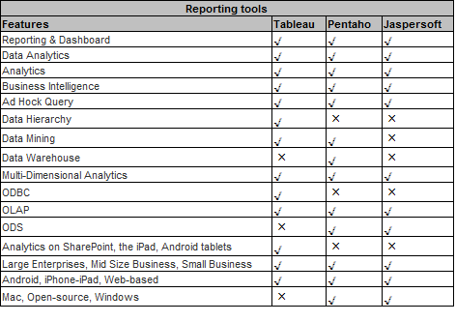
Reporting tools comparison

Slide 31
Map Reduce Alternatives
Here are some MapReduce-ish implementations, all of which are either coupled to a single storage system, a single programming language, or implement only a small subset of the features of a mature MapReduce implementation:
· Disco: ··http://discoproject.org
· Misco: ··http://www.cs.ucr.edu/~jdou/misco/
· Phoenix: ··http://mapreduce.stanford.edu
· Cloud MapReduce: ··http://code.google.com/p/cloudma...
· bashreduce: ··http://blog.last.fm/2009/04/06/m...
· Qizmt: ··http://code.google.com/p/qizmt
· HTTPMR: ··http://code.google.com/p/httpmr

Slide 32
Map Reduce Alternatives
Galago's TupleFlow: ··http://www.galagosearch.org/guid...
· Skynet: ··http://skynet.rubyforge.org
· Sphere: ··http://sector.sourceforge.net
· Riak: ··http://riak.basho.com/mapreduce....
· Starfish: ··http://rufy.com/starfish/doc/
· Octopy: ··http://code.google.com/p/octopy/
· MPI-MR: ··http://www.sandia.gov/~sjplimp/m...
· Filemap: ··http://mfisk.github.com/filemap/
· Plasma MapReduce: ··http://projects.camlcity.org/pro...

Slide 33
Map Reduce Alternatives
Galago's TupleFlow: ··http://www.galagosearch.org/guid...
· Skynet: ··http://skynet.rubyforge.org
· Sphere: ··http://sector.sourceforge.net
· Riak: ··http://riak.basho.com/mapreduce....
· Starfish: ··http://rufy.com/starfish/doc/
· Octopy: ··http://code.google.com/p/octopy/
· MPI-MR: ··http://www.sandia.gov/~sjplimp/m...
· Filemap: ··http://mfisk.github.com/filemap/
· Plasma MapReduce: ··http://projects.camlcity.org/pro...

Slide 34
Map Reduce Alternatives
Mapredus: ··http://rubygems.org/gems/mapredus
· Mincemeat: ··http://remembersaurus.com/mincem...
· MapReduceTitan: ··http://www.kitware.com/InfovisWi...
· GPMR: ··http://www.idav.ucdavis.edu/rese...
· Elastic Phoenix: ··https://github.com/adamwg/elasti...
· Preregrine: ··http://peregrine_mapreduce.bitbu...
· R3: ··http://heynemann.github.com/r3/

Slide 35
Hadoop Alternatives
1. HPCC (High Performance Computing Cluster) is a massive parallel-processing computing platform that solves Big Data problems. The platform is Open Source!
2. BashReduce: a toy project bashreduce lets us address a common scenario around these parts: we have a few analysis machines lying around, and we have data from various systems that are not in Hadoop. Rather than go through the rigmarole of sending it to our Hadoop cluster and writing yet another one-off Java or Dumbo program, we instead fire off a one-liner bashreduce using tools we already know in our reducer: sort, awk, grep, join, and so on.
3. Disco Project : Disco is a lightweight, open-source framework for distributed computing based on the MapReduce paradigm. Disco is powerful and easy to use, thanks to Python. Disco distributes and replicates your data, and schedules your jobs efficiently. Disco even includes the tools you need to index billions of data points and query them in real-time. Disco was born in Nokia Research Center in 2008 to solve real challenges in handling massive amounts of data. Disco has been actively developed since then by Nokia and many other companies who use it for a variety of purposes, such as log analysis, probabilistic modelling, data mining, and full-text indexing.

Slide 36
Hadoop Alternatives
4. Apache Spark : Apache Spark is an open source cluster computing system that aims to make data analytics fast — both fast to run and fast to write.To run programs faster, Spark offers a general execution model that can optimize arbitrary operator graphs, and supports in-memory computing, which lets it query data faster than disk-based engines like Hadoop.To make programming faster, Spark provides clean, concise APIs in Scala, Java and Python. You can also use Spark interactively from the Scala and Python shells to rapidly query big datasets.
5. GraphLab: GraphLab is a graph-based, high performance, open source distributed computation framework written in C++. While GraphLab was originally developed for Machine Learning tasks, it has found great success at a broad range of other data-mining tasks; out-performing other abstractions by orders of magnitude. Our latest beta is a cloud based ipython interface to GraphLab. GraphLab office is located in UW campus in Seattle.
7. Stratosphere: Microsoft Research project
8. Storm: free opren source distributed realtime computation system. Reliably process unbounded streams of data for realtime processing what hadoop did for batch processing. Its simple and easy to use.

Slide 37
How HPCC works
The HPCC Systems architecture incorporates the Thor and Roxie clusters as well as common middleware components, an external communications layer, client interfaces which provide both end-user services and system management tools, and auxiliary components to support monitoring and to facilitate loading and storing of filesystem data from external sources. An HPCC environment can include only Thor clusters, or both Thor and Roxie clusters.
below is the architecture diagram.

Slide 38
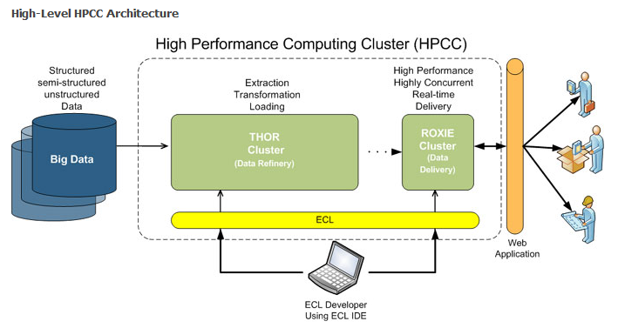
How HPCC works
.

Slide 39
Thor (the Data Refinery Cluster) is responsible for consuming vast amounts of data, transforming, linking and indexing that data. It functions as a distributed file system with parallel processing power spread across the nodes. A cluster can scale from a single node to thousands of nodes.
· Single-threaded
· Distributed parallel processing
· Distributed file system
· Powerful parallel processing programming language (ECL)
· Optimized for Extraction, Transformation, Loading, Sorting, Indexing and Linking
· Scales from 1-1000s of nodes

Slide 40
Roxie (the Query Cluster) provides separate high-performance online query processing and data warehouse capabilities.
· Multi-threaded
· Distributed parallel processing
· Distributed file system
· Powerful parallel processing programming language (ECL)
· Optimized for concurrent query processing
· Scales from 1-1000s of nodes

Slide 41
ECL (Enterprise Control Language) is the powerful programming language that is ideally suited for the manipulation of Big Data.
· Transparent and implicitly parallel programming language
· Non-procedural and dataflow oriented
· Modular, reusable, extensible syntax
· Combines data representation and algorithm implementation
· Easily extend using C++ libraries
· ECL is compiled into optimized C++

Slide 42
ECL IDE is a modern IDE used to code, debug and monitor ECL programs.
· Access to shared source code repositories
· Complete development, debugging and testing environment for developing ECL dataflow programs
· Access to the ECLWatch tool is built-in, allowing developers to watch job graphs as they are executing
· Access to current and historical job workunits
ESP (Enterprise Services Platform) provides an easy to use interface to access ECL queries using XML, HTTP, SOAP and REST.
· Standards-based interface to access ECL functions
· Supports SOAP, XML, HTTP and REST
· Supports SAML and various security standards

Slide 43
DISCO project
Disco is an implementation of mapreduce for distributed computing. Disco supports parallel computations over large data sets, stored on an unreliable cluster of computers, as in the original framework created by Google. This makes it a perfect tool for analyzing and processing large data sets, without having to worry about difficult technicalities related to distribution such as communication protocols, load balancing, locking, job scheduling, and fault tolerance, which are handled by Disco.
Disco can be used for a variety data mining tasks: large-scale analytics, building probabilistic models, and full-text indexing the Web, just to name a few examples.
The Disco core is written in Erlang, a functional language that is designed for building robust fault-tolerant distributed applications. Users of Disco typically write jobs in Python, which makes it possible to express even complex algorithms with very little code.

Slide 44
    Main features
· Proven to scale to hundreds of CPUs and tens of thousands of simultaneous tasks.
· Used to process datasets in the scale of tens of terabytes.
· Extremely simple to use: A typical tasks consists of two functions written in Python and two calls to the Disco API.
· Tasks can be specified in any other language as well, by implementing the Disco worker protocol.
· Input data can be in any format, even binary data such as images. The data can be located on any source that is accesible by HTTP or it can distributed to local disks.
· Fault-tolerant: Server crashes don’t interrupt jobs. New servers can be added to the system on the fly.

Slide 45
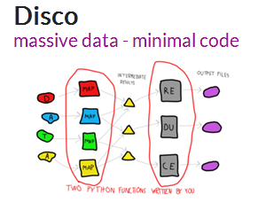
Flexible: In addition to the core map and reduce functions, a combiner function, a partition function and an input reader can be provided by the user.
· Easy to integrate to larger applications using the standard Disco module and the Web APIs.
· Comes with a built-in distributed storage system (··Disco Distributed Filesystem).

Slide 46
    Highlights
· Easy to ··install on Linux or Mac OS X and ··use.
· Efficient data-locality-preserving IO, either over HTTP or the builtin petabyte-scale ··Disco Distributed Filesystem.
· Supports ··profiling and debugging of mapreduce jobs.
· Random access data and auxiliary results through ··out of band results.
· Run jobs written in any language using the ··worker protocol.
· Build and query indices with billions of keys and values, using ··DiscoDB

Slide 47
Apache Spark
    What is Apache Spark?
Apache Spark is an open source cluster computing system that aims to make data analytics fast — both fast to run and fast to write.
To run programs faster, Spark offers a general execution model that can optimize arbitrary operator graphs, and supports in-memory computing, which lets it query data faster than disk-based engines like Hadoop.
To make programming faster, Spark provides clean, concise APIs in Scala, Java and Python. You can also use Spark interactively from the Scala and Python shells to rapidly query big datasets.

Slide 48
Apache Spark
    What can it do?
Spark was initially developed for two applications where placing data in memory helps: iterative algorithms, which are common in machine learning, and interactive data mining. In both cases, Spark can run up to 100x faster than Hadoop MapReduce. However, you can use Spark for general data processing too. Check out our example jobs.
Spark is also the engine behind Shark, a fully Apache Hive-compatible data warehousing system that can run 100x faster than Hive.
While Spark is a new engine, it can access any data source supported by Hadoop, making it easy to run over existing data.

Slide 49
Apache Spark
    Who uses it?
Spark was initially created in the UC Berkeley AMPLab, but is now being used and developed at a wide array of companies. See our powered by page for a list of users, and our list of committers. In total, over 25 companies have contributed code to Spark. Spark is open source under an Apache license, so download it to try it out.

Slide 50
GraphLab
The GraphLab journey began with the desire:
· to rethink the way we approach Machine Learning and Graph analytics,
· to demonstrate that with the right abstractions and system design we can achieve unprecedented levels of performance, and
· to build a community around large-scale graph computation.

